Slide 1
Deploying Redis AI on top of Redis Gears NLP pipeline
Dr Alexander Mikhalev
Geek in Data Architecture team in Nationwide Building Society

Slide 2
Deploying Redis AI on top of Redis Gears NLP pipeline
Dr Alexander Mikhalev
Geek in Data Architecture team in Nationwide Building Society

Slide 3
Agenda
Introduce yourself
NLP Pipeline build on “Redis Beyond Cache 2020 Hackathron”
The Challenge you wanted address
Redis Gears and Redis AI
The Solution
Results: what worked / didn’t work?
Next steps / more resources
Key learnings / takeaways

Slide 4

Dr Alexander Mikhalev
Geek in Data Architecture team in Nationwide Building Society
Passionate researcher and developer, ready to dive into new technologies and developing new things. I have a wide and diverse set of knowledge ranging from natural language processing to wireless and wired networks. I have a systematic approach to innovation and the ability to solve complex problems, for example in 2018 I run a "skunkworks lab" inside Nationwide Building Society which resulted in the first patent in the history of society on the topic of secure distribution of data.

Slide 5
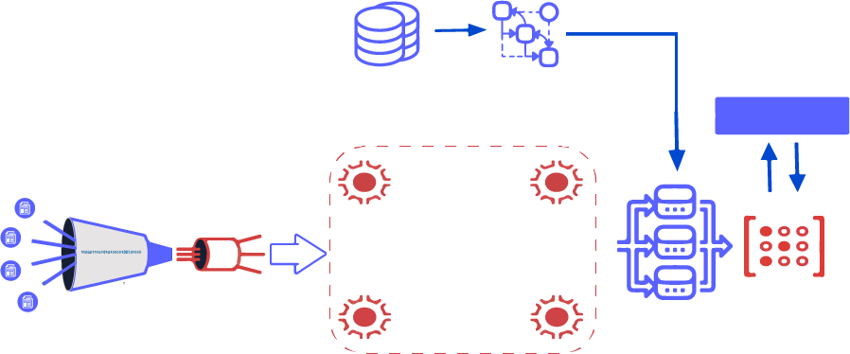
NLP Pipeline build in 2020 (medium complexity project)
Read UMLS table
Build automata
Flask API
Extract & parse cord-19 documents
Create streams
Language
detector
Spell
checker
Split
paragraphs
Redis Graph
Matcher
Redis Gears
Notes:
Why do you need RedisGears based pipeline? While 50 thousands articles is a small dataset by modern standard, it’s more than single laptop can handle. Redis Gears provides a very easy way to create a distributed data processing. We will be re-using half of the pipeline - until matcher step, but then we fork and adjust pipeline to use Redis AI

Slide 6
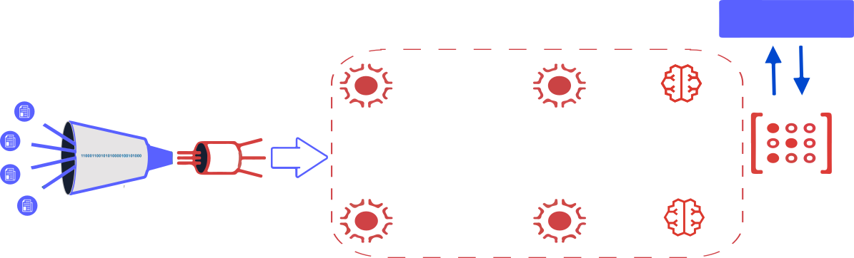
NLP Pipeline with Redis AI
Flask API
Extract & parse cord-19 documents
Language
detector
Spell
checker
Split
paragraphs
RedisAI
RedisGears
RedisAI

Slide 7
The Challenge
Solution Overview
Pre-Process articles using Redis Gears
Pre-load models for QA into Redis AI and RedisGears
Create API to run inference for QA using Redis AI distributing compute by RedisGears
I would like to incorporate modern machine learning models into NLP pipeline for Question Answering (like chatbot)
Creating a BERT based Question Answering services is quite straightforward, except even on such “small” dataset as cord19, API response time will 10-15 seconds which isn’t good users experience.
This is where Redis and Redis Modules come into picture.
Notes:
vision which I have been thinking about for a while: work with information should not be limited to 2D and we are looking for “things not strings”. Using Redis technologies whenever possible.

Slide 8
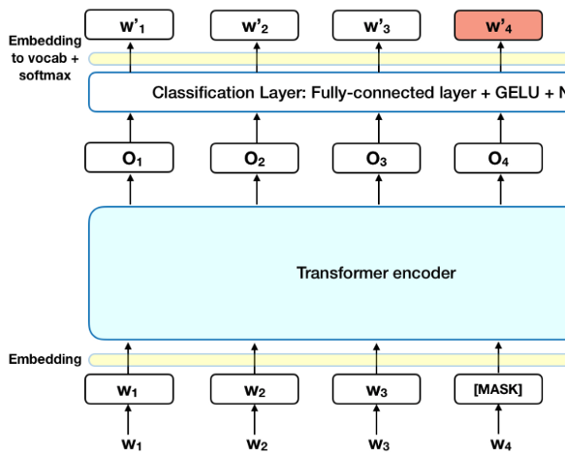
BERT models introduction
BERT (Bidirectional Encoder Representations from Transformers)
Created by researchers at Google AI Language
State-of-the-art results in a wide variety of NLP tasks, including Question Answering (SQuAD v1.1), Natural Language Inference (MNLI), and others.
Read more about BERT at Towards Data Science blog

Slide 9
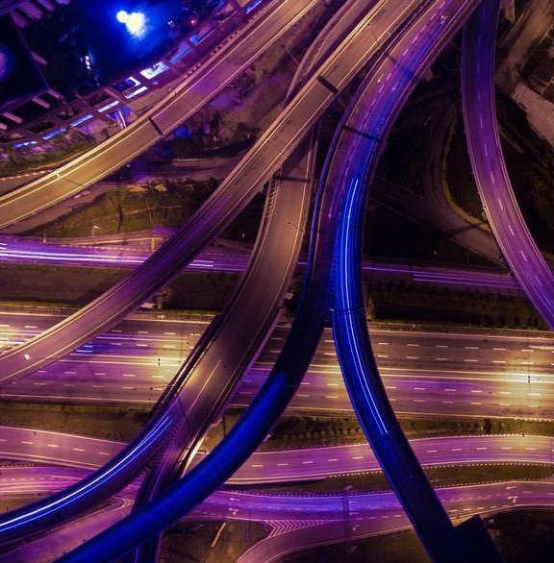
BERT models Use Cases
Next Sentence Prediction
Text Summarization
Question Answering
Text classification and many more

Slide 10
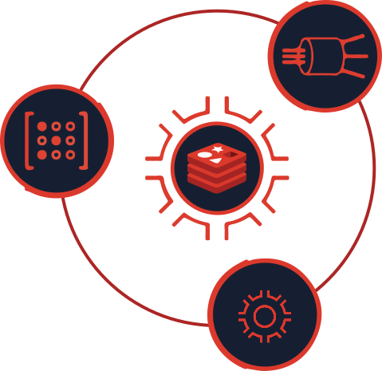
Solution Overview: NLP pipeline
0. Intake step - is very simple and nothing to write about: pump all JSON records into RedisCluster, then NLP pipeline starts processing all records, code is here .
How are the steps of the NLP pipeline fit into RedisGears?
For each record — detect language (discard non English), it’s “filter”
Map paragraphs into a sentence — flatmap
Sentences spellchecker — it’s “map”
Save sentences into hash — processor
Now we will add API for Extractive Question Answering using BERT model running inside Redis AI

Slide 11
Redis Cluster and Redis Gears configuration
Redis Cluster with RedisGears deployed using rgcluster docker and/or redis-cluster script
Make sure it’s HA configuration - each master have replica
Increasing execution time and set parameters
create-cluster call RG.CONFIGSET ExecutionMaxIdleTime 300000
create-cluster call CONFIG SET proto-max-bulk-len 2048mb
create-cluster call CONFIG SET cluster-node-timeout 30000
launch code using docker or docker-compose

Slide 12
Demo
http://thepattern.digital

Slide 13

Next Steps
Integrate QA API with chat bot framework or interface or with Alexa/Google
Pre-tokenize text (contexts) using Redis Gears function
Create BERT (BART/T5) Summarization for articles model produceses summary

Slide 14
More Resources
Project documentation https://alexmikhalev.github.io/cord19redisknowledgegraph
Overall Github repo https://github.com/applied-knowledge-systems/the-pattern
Live demo http://thepattern.digital
Join our team on Discord

Slide 15
Key Learnings / Takeaways
We build a Knowledge Graph from the text and then build a multiple interfaces to the same Knowledge Graph
All using Redis and Redis Modules - there is no move in and out of datastore for processing
Use Redis for cache - it’s memory efficient and fast
Use Redis Gears for processing data without moving data in and out of memory
Use Redis AI for inference avoiding the need to move information in and out of Redis
The Pattern project build for fun and collaboration - bring your own ideas and code

Slide 16
Team Acknowledgment
Thank you to Brian Wachanga (https://github.com/mcwachanga) for building such a great UX to the NLP pipeline and to Gavid D'mello (https://github.com/GavinDmello) for participation in Redis Beyond Cache hackathon.
Separate thanks to Meir, Dvir and the rest of Redis Labs team for support and bugfixes

